Slide 1
Data Mining: Concepts and Techniques
Dr Naima Iltaf
Dept of Computer Software Engineering
nazia.bse786@gmail.com
Research interest
Recommender System
Trust Management
Image Processing
Distributed Systems

Slide 2
Why Data Mining?
The Explosive Growth of Data: from terabytes to petabytes
Data collection and data availability
Automated data collection tools, database systems, Web, computerized society
Major sources of abundant data
Business: Web, e-commerce, transactions, stocks, …
Science: Remote sensing, bioinformatics, scientific simulation, …
Society and everyone: news, digital cameras, YouTube
We are drowning in data, but starving for knowledge!
“Necessity is the mother of invention”—Data mining—Automated analysis of massive data sets

Slide 3
Evolution of Sciences
Before 1600, empirical (experimental) science
1600-1950s, theoretical science
Each discipline has grown a theoretical component. Theoretical models often motivate experiments and generalize our understanding.
1950s-1990s, computational science
Over the last 50 years, most disciplines have grown a third, computational branch (e.g. empirical, theoretical, and computational ecology, or physics, or linguistics.)
Computational Science traditionally meant simulation. It grew out of our inability to find closed-form solutions for complex mathematical models.
1990-now, data science
The flood of data from new scientific instruments and simulations
The ability to economically store and manage petabytes of data online
The Internet and computing Grid that makes all these archives universally accessible
Scientific info. management, acquisition, organization, query, and visualization tasks scale almost linearly with data volumes. Data mining is a major new challenge!
Jim Gray and Alex Szalay, The World Wide Telescope: An Archetype for Online Science, Comm. ACM, 45(11): 50-54, Nov. 2002

Slide 4
Evolution of Database Technology
1960s:
Data collection, database creation, IMS and network DBMS
1970s:
Relational data model, relational DBMS implementation
1980s:
RDBMS, advanced data models (extended-relational, OO, deductive, etc.)
Application-oriented DBMS (spatial, scientific, engineering, etc.)
1990s:
Data mining, data warehousing, multimedia databases, and Web databases
2000s
Stream data management and mining
Data mining and its applications
Web technology (XML, data integration) and global information systems

Slide 5
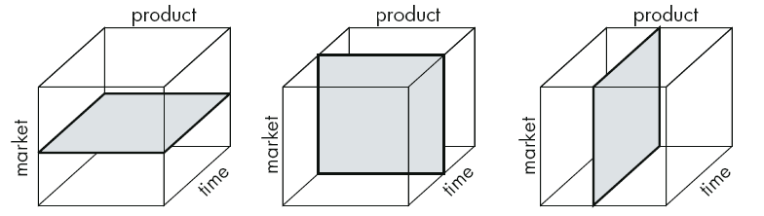
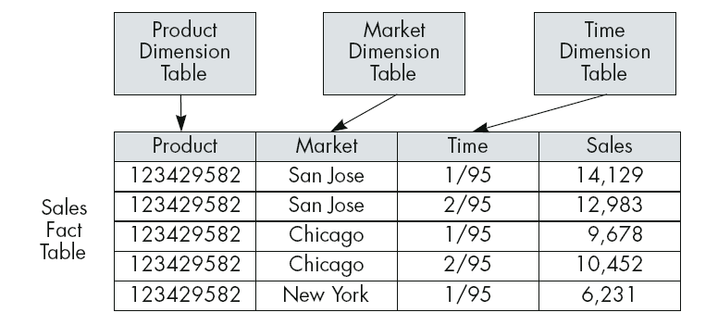
Data Mining is not …
Generating multidimensional cubes of a relational table

Slide 6
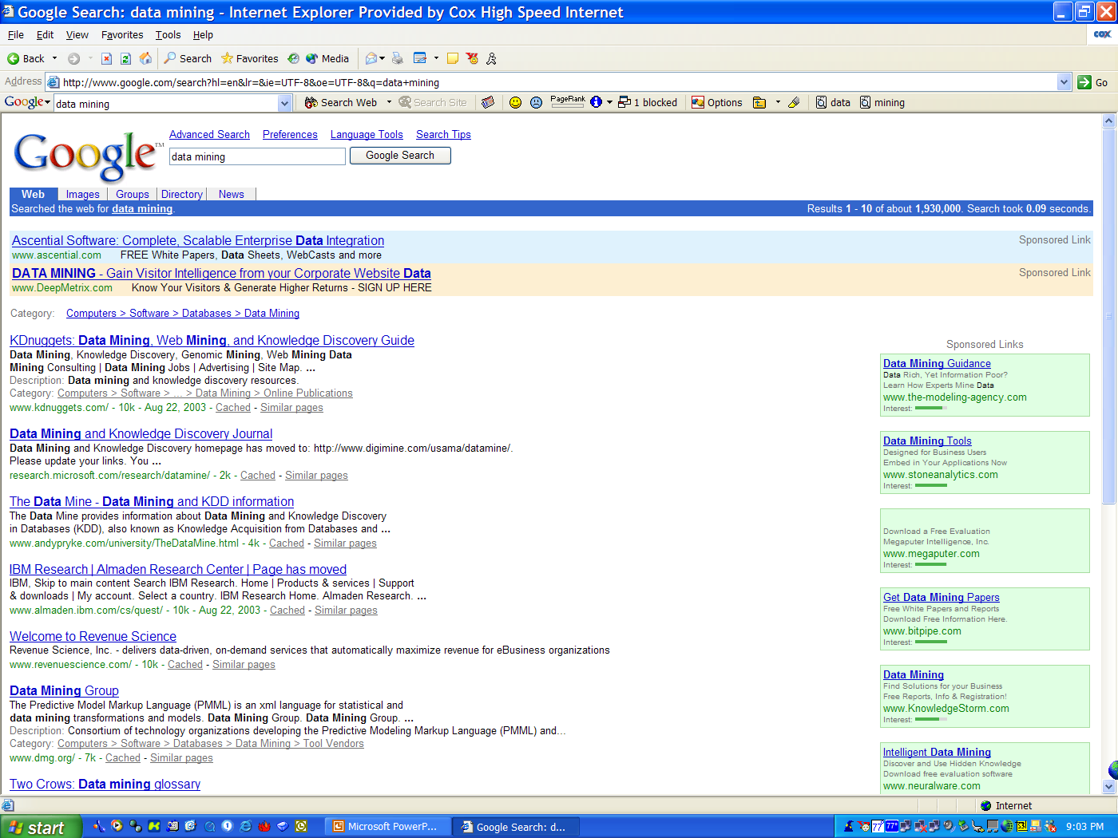
Data Mining is not …
Searching for a phone number in a phone book
Searching for keywords on Google

Slide 7


Data Mining is not …
Generating a histogram of salaries for different age groups
Issuing SQL query to a database, and reading the reply

Slide 8
What Is Data Mining?
Data mining (knowledge discovery from data)
Extraction of interesting (non-trivial, implicit, previously unknown and potentially useful) patterns or knowledge from huge amount of data
Data mining: a misnomer?
Alternative names
Knowledge discovery (mining) in databases (KDD), knowledge extraction, data/pattern analysis, data archeology, data dredging, information harvesting, business intelligence, etc.
Watch out: Is everything “data mining”?
Simple search and query processing
(Deductive) expert systems

Slide 9
Data Mining and Business Intelligence
Increasing potential
to support
business decisions
End User
Decision Making
Data Presentation
Business
Analyst
Visualization Techniques
Data Mining
Data
Analyst
Information Discovery
Data Exploration
Statistical Summary, Querying, and Reporting
Data Preprocessing/Integration, Data Warehouses
Data Sources
DBA
Paper, Files, Web documents, Scientific experiments, Database Systems

Slide 10
Data Mining: Confluence of Multiple Disciplines
Database
Technology
Statistics
Machine
Learning
Data Mining
Visualization
Pattern
Recognition
Other
Disciplines
Algorithm

Slide 11
Why Not Traditional Data Analysis?
Tremendous amount of data
Algorithms must be highly scalable to handle such as tera-bytes of data
High-dimensionality of data
Micro-array may have tens of thousands of dimensions
High complexity of data
Data streams and sensor data
Time-series data, temporal data, sequence data
Structure data, graphs, social networks and multi-linked data
Heterogeneous databases and legacy databases
Spatial, spatiotemporal, multimedia, text and Web data
Software programs, scientific simulations
New and sophisticated applications

Slide 12
Multi-Dimensional View of Data Mining
Data to be mined
Relational, data warehouse, transactional, stream, object-oriented/relational, active, spatial, time-series, text, multi-media, heterogeneous, legacy, WWW
Knowledge to be mined
Characterization, discrimination, association, classification, clustering, trend/deviation, outlier analysis, etc.
Multiple/integrated functions and mining at multiple levels
Techniques utilized
Database-oriented, data warehouse (OLAP), machine learning, statistics, visualization, etc.
Applications adapted
Retail, telecommunication, banking, fraud analysis, bio-data mining, stock market analysis, text mining, Web mining, etc.

Slide 13
Data Mining Functionalities
Multidimensional concept description: Characterization and discrimination
Generalize, summarize, and contrast data characteristics, e.g., dry vs. wet regions
Frequent patterns, association, correlation vs. causality
Diaper → Milk [0.5%, 75%] (Correlation or causality?)
Classification and prediction
Construct models (functions) that describe and distinguish classes or concepts for future prediction
E.g., classify countries based on (climate), or classify cars based on (gas mileage (range))
Predict some unknown or missing numerical values

Slide 14
Data Mining Functionalities (2)
Cluster analysis
Class label is unknown: Group data to form new classes, e.g., cluster houses to find distribution patterns
Maximizing intra-class similarity & minimizing interclass similarity
Outlier analysis
Outlier: Data object that does not comply with the general behavior of the data
Noise or exception? Useful in fraud detection, rare events analysis
Trend and evolution analysis
Trend and deviation: e.g., regression analysis
Sequential pattern mining: e.g., digital camera → large SD memory
Periodicity analysis
Similarity-based analysis
Other pattern-directed or statistical analyses

Slide 15
Top-10 Most Popular DM Algorithms: 18 Identified Candidates (I)
Classification
#1. C4.5: Quinlan, J. R. C4.5: Programs for Machine Learning. Morgan Kaufmann., 1993.
#2. CART: L. Breiman, J. Friedman, R. Olshen, and C. Stone. Classification and Regression Trees. Wadsworth, 1984.
#3. K Nearest Neighbours (kNN): Hastie, T. and Tibshirani, R. 1996. Discriminant Adaptive Nearest Neighbor Classification. TPAMI. 18(6)
#4. Naive Bayes Hand, D.J., Yu, K., 2001. Idiot's Bayes: Not So Stupid After All? Internat. Statist. Rev. 69, 385-398.
Statistical Learning
#5. SVM: Vapnik, V. N. 1995. The Nature of Statistical Learning Theory. Springer-Verlag.
#6. EM: McLachlan, G. and Peel, D. (2000). Finite Mixture Models. J. Wiley, New York. Association Analysis
#7. Apriori: Rakesh Agrawal and Ramakrishnan Srikant. Fast Algorithms for Mining Association Rules. In VLDB '94.
#8. FP-Tree: Han, J., Pei, J., and Yin, Y. 2000. Mining frequent patterns without candidate generation. In SIGMOD '00.

Slide 16
The 18 Identified Candidates (II)
Link Mining
#9. PageRank: Brin, S. and Page, L. 1998. The anatomy of a large-scale hypertextual Web search engine. In WWW-7, 1998.
#10. HITS: Kleinberg, J. M. 1998. Authoritative sources in a hyperlinked environment. SODA, 1998.
Clustering
#11. K-Means: MacQueen, J. B., Some methods for classification and analysis of multivariate observations, in Proc. 5th Berkeley Symp. Mathematical Statistics and Probability, 1967.
#12. BIRCH: Zhang, T., Ramakrishnan, R., and Livny, M. 1996. BIRCH: an efficient data clustering method for very large databases. In SIGMOD '96.
Bagging and Boosting
#13. AdaBoost: Freund, Y. and Schapire, R. E. 1997. A decision-theoretic generalization of on-line learning and an application to boosting. J. Comput. Syst. Sci. 55, 1 (Aug. 1997), 119-139.

Slide 17
The 18 Identified Candidates (III)
Sequential Patterns
#14. GSP: Srikant, R. and Agrawal, R. 1996. Mining Sequential Patterns: Generalizations and Performance Improvements. In Proceedings of the 5th International Conference on Extending Database Technology, 1996.
#15. PrefixSpan: J. Pei, J. Han, B. Mortazavi-Asl, H. Pinto, Q. Chen, U. Dayal and M-C. Hsu. PrefixSpan: Mining Sequential Patterns Efficiently by Prefix-Projected Pattern Growth. In ICDE '01.
Integrated Mining
#16. CBA: Liu, B., Hsu, W. and Ma, Y. M. Integrating classification and association rule mining. KDD-98.
Rough Sets
#17. Finding reduct: Zdzislaw Pawlak, Rough Sets: Theoretical Aspects of Reasoning about Data, Kluwer Academic Publishers, Norwell, MA, 1992
Graph Mining
#18. gSpan: Yan, X. and Han, J. 2002. gSpan: Graph-Based Substructure Pattern Mining. In ICDM '02.

Slide 18
Major Issues in Data Mining
Mining methodology
Mining different kinds of knowledge from diverse data types, e.g., bio, stream, Web
Performance: efficiency, effectiveness, and scalability
Pattern evaluation: the interestingness problem
Incorporation of background knowledge
Handling noise and incomplete data
Parallel, distributed and incremental mining methods
Integration of the discovered knowledge with existing one: knowledge fusion
User interaction
Data mining query languages and ad-hoc mining
Expression and visualization of data mining results
Interactive mining of knowledge at multiple levels of abstraction
Applications and social impacts
Domain-specific data mining & invisible data mining
Protection of data security, integrity, and privacy

Slide 19
Data Mining—Potential Applications
Data analysis and decision support
Market analysis and management
Target marketing, customer relationship management (CRM), market basket analysis, cross selling, market segmentation
Risk analysis and management
Forecasting, customer retention, improved underwriting, quality control, competitive analysis
Fraud detection and detection of unusual patterns (outliers)
Other Applications
Text mining (news group, email, documents) and Web mining
Stream data mining
Bioinformatics and bio-data analysis

Slide 20
Ex. 1: Market Analysis and Management
Where does the data come from?—Credit card transactions, loyalty cards, discount coupons, customer complaint calls, plus (public) lifestyle studies
Target marketing
Find clusters of “model” customers who share the same characteristics: interest, income level, spending habits, etc.
Determine customer purchasing patterns over time
Cross-market analysis—Find associations/co-relations between product sales, & predict based on such association
Customer profiling—What types of customers buy what products (clustering or classification)
Customer requirement analysis
Identify the best products for different groups of customers
Predict what factors will attract new customers
Provision of summary information
Multidimensional summary reports
Statistical summary information (data central tendency and variation)

Slide 21
Ex. 2: Corporate Analysis & Risk Management
Finance planning and asset evaluation
cash flow analysis and prediction
contingent claim analysis to evaluate assets
cross-sectional and time series analysis (financial-ratio, trend analysis, etc.)
Resource planning
summarize and compare the resources and spending
Competition
monitor competitors and market directions
group customers into classes and a class-based pricing procedure
set pricing strategy in a highly competitive market

Slide 22
Ex. 3: Fraud Detection & Mining Unusual Patterns
Approaches: Clustering & model construction for frauds, outlier analysis
Applications: Health care, retail, credit card service, telecomm.
Auto insurance: ring of collisions
Money laundering: suspicious monetary transactions
Medical insurance
Professional patients, ring of doctors, and ring of references
Unnecessary or correlated screening tests
Telecommunications: phone-call fraud
Phone call model: destination of the call, duration, time of day or week. Analyze patterns that deviate from an expected norm
Retail (selling/marketing) industry
Analysts estimate that 38% of retail shrink is due to dishonest employees
Anti-terrorism

Slide 23
Summary
Data mining: Discovering interesting patterns from large amounts of data
A natural evolution of database technology, in great demand, with wide applications
A KDD process includes data cleaning, data integration, data selection, transformation, data mining, pattern evaluation, and knowledge presentation
Mining can be performed in a variety of information repositories
Data mining functionalities: characterization, discrimination, association, classification, clustering, outlier and trend analysis, etc.
Data mining systems and architectures
Major issues in data mining

Slide 24
Topic to be Covered
Introduction to Data Mining
Data Reduction
Clustering
Classification
Association Analysis
Link analysis
Outlier mining
Sequence mining
Text Mining
Web mining
Recommender System

Slide 25
Course Resources
Jiawei Han ”Data Mining: Concepts and Techniques”, Second Edition and above
Anything that you can find to help you learn.

